Slide 1


Noida Institute of Engineering and Technology, Greater Noida
Uninformed search strategies
Unit: 02
Introduction to Search
B Tech 3rd Sem
Alka Singh
CSE (AIML)

Slide 2
Search Algorithms in AI
Artificial Intelligence is the study of building agents that act rationally. Most of the time, these agents perform some kind of search algorithm in the background in order to achieve their tasks.
A search problem consists of:
  A State Space: Set of all possible states where you can be.
  A Start State: The state from where the search begins.

Slide 3
Search Algorithms in AI
  A Goal Test: A function that looks at the current state returns whether or not it is the goal state.
The Solution to a search problem is a sequence of actions, called the plan that transforms the start state to the goal state.
This plan is achieved through search algorithms.

Slide 4
Properties of Search Algorithms
Following are the four essential properties of search algorithms:
Completeness: A search algorithm is said to be complete if it guarantees to return a solution if at least any solution exists for any random input.
Optimality: If a solution found for an algorithm is guaranteed to be the best solution (lowest path cost) among all other solutions, then such a solution for is said to be an optimal solution.

Slide 5
Properties of Search Algorithms
3. Time Complexity: Time complexity is a measure of time for an algorithm to complete its task.
4. Space Complexity: It is the maximum storage space required at any point during the search, as the complexity of the problem.

Slide 6
MCQ
Q 1. What is state space?
a) The whole problem
b) Your Definition to a problem
c) Problem you design
d) Representing your problem with variable and parameter
Answer:d

Slide 7
MCQ
Q 2 . A search algorithm takes _________ as an input and returns ________ as an output.
a) Input, output
b) Problem, solution
c) Solution, problem
d) Parameters, sequence of actions
Answer: b

Slide 8
MCQ
Q 3. A problem in a search space is defined by one of these state.
a) Initial state
b) Last state
c) Intermediate state
d) All of the mentioned
Answer: a

Slide 9
MCQ
Q 4. The Set of actions for a problem in a state space is formulated by a ___________
a) Intermediate states
b) Initial state
c) Successor function, which takes current action and returns next immediate state
d) None of the mentioned
Answer: c

Slide 10
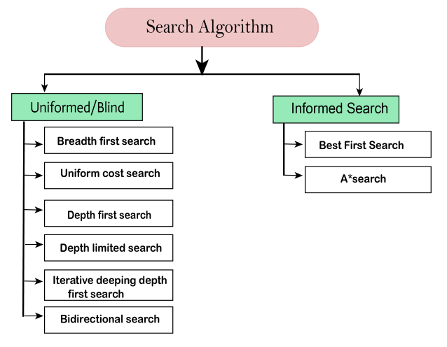
Types of Search Algorithms
There are far too many powerful search algorithms.

Slide 11
Uninformed Search Algorithms
Uninformed search is a class of general-purpose search algorithms which operates in brute force-way.
Uninformed search algorithms do not have additional information about state or search space other than how to traverse the tree, so it is also called blind search.
Following are the various types of uninformed search algorithms.

Slide 12
Uninformed Search Algorithms
Breadth-first Search
Depth-first Search
Uniform cost search

Slide 13
Uninformed Search Algorithms
Each of these algorithms will have:
A problem graph, containing the start node S and the goal node G.
A strategy, describing the manner in which the graph will be traversed to get to G .
A fringe, which is a data structure used to store all the possible states (nodes) that you can go from the current states.
A tree, that results while traversing to the goal node.
A solution plan, which the sequence of nodes from S to G

Slide 14
Breadth-first Search
Breadth-first search is the most common search strategy for traversing a tree or graph. This algorithm searches breadth wise in a tree or graph, so it is called breadth-first search.
BFS algorithm starts searching from the root node of the tree and expands all successor node at the current level before moving to nodes of next level.

Slide 15
Breadth-first Search
The breadth-first search algorithm is an example of a general-graph search algorithm.
Breadth-first search implemented using FIFO queue data structure.

Slide 16
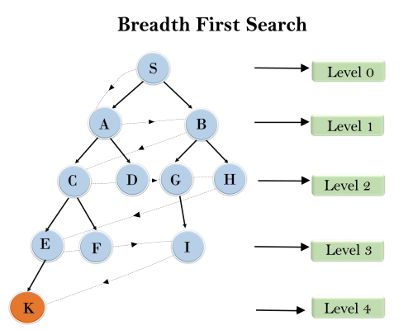
Continue…

Slide 17
Continue…
Example:
In the above tree structure, we have shown the traversing of the tree using BFS algorithm from the root node S to goal node K.
BFS search algorithm traverse in layers, so it will follow the path as
S---> A--->B---->C--->D---->G--->H--->E---->F---->I---->K

Slide 18
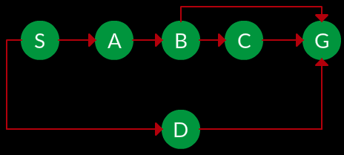
Continue…
Question. Which solution would BFS find to move from node S to node G if run on the graph below?

Slide 19
Continue…
Solution. The equivalent search tree for the above graph is as below. As BFS traverses the tree “shallowest node first”, it would always pick the shallower branch until it reaches the solution (or it runs out of nodes, and goes to the next branch). The traversal is shown in blue arrows.
Path: S -> D -> G

Slide 20
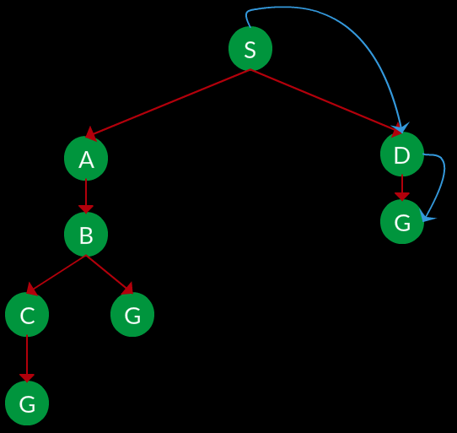
Continue…

Slide 21
Continue…
Advantages:
BFS will provide a solution if any solution exists.
If there are more than one solutions for a given problem, then BFS will provide the minimal solution which requires the least number of steps.

Slide 22
Continue…
Disadvantages:
It requires lots of memory since each level of the tree must be saved into memory to expand the next level.
BFS needs lots of time if the solution is far away from the root node.

Slide 23
Continue…
Time Complexity: Time Complexity of BFS algorithm can be obtained by the number of nodes traversed in BFS until the shallowest Node. Where the d= depth of shallowest solution and b is a node at every state.
T (b) = O (b^{d})
Space Complexity: Space complexity of BFS algorithm is given by the Memory size of frontier which is O(b^{d}).

Slide 24
Depth-first Search
Depth-first search is a recursive algorithm for traversing a tree or graph data structure.
It is called the depth-first search because it starts from the root node and follows each path to its greatest depth node before moving to the next path.
DFS uses a stack data structure for its implementation.
The process of the DFS algorithm is similar to the BFS algorithm.

Slide 25
Continue…
Note: Backtracking is an algorithm technique for finding all possible solutions using recursion.
Advantage:
DFS requires very less memory as it only needs to store a stack of the nodes on the path from root node to the current node.
It takes less time to reach to the goal node than BFS algorithm (if it traverses in the right path).

Slide 26
Disadvantage:
There is the possibility that many states keep re-occurring, and there is no guarantee of finding the solution.
DFS algorithm goes for deep down searching and sometime it may go to the infinite loop.
Example:
In the below search tree, we have shown the flow of depth-first search, and it will follow the order as:
Root node--->Left node ----> right node.

Slide 27
Continue…
It will start searching from root node S, and traverse A, then B, then D and E, after traversing E, it will backtrack the tree as E has no other successor and still goal node is not found. After backtracking it will traverse node C and then G, and here it will terminate as it found goal node.

Slide 28
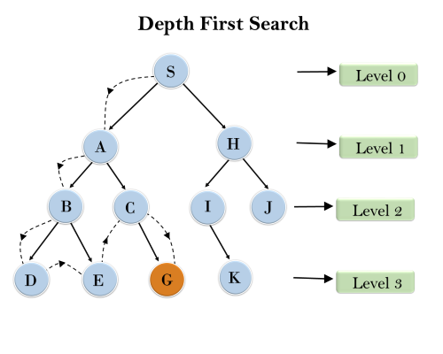
Continue…

Slide 29
Continue…
Completeness: DFS search algorithm is complete within finite state space as it will expand every node within a limited search tree.
Time Complexity: Time complexity of DFS will be equivalent to the node traversed by the algorithm. It is given by: T(n)= 1+ n²+ n³ +.........+ n^{m}=O(n^{m})
Where, m= maximum depth of any node and this can be much larger than d (Shallowest solution depth)

Slide 30
Continue…
Space Complexity: DFS algorithm needs to store only single path from the root node, hence space complexity of DFS is equivalent to the size of the fringe set, which is O(bm).
Optimal: DFS search algorithm is non-optimal, as it may generate a large number of steps or high cost to reach to the goal node.

Slide 31
.
Uniform-cost Search Algorithm
Uniform-cost search is a searching algorithm used for traversing a weighted tree or graph.
This algorithm comes into play when a different cost is available for each edge.
The primary goal of the uniform-cost search is to find a path to the goal node which has the lowest cumulative cost.
Uniform-cost search expands nodes according to their path costs form the root node. It can be used to solve any graph/tree where the optimal cost is in demand.

Slide 32
Continue…
A uniform-cost search algorithm is implemented by the priority queue. It gives maximum priority to the lowest cumulative cost.
Uniform cost search is equivalent to BFS algorithm if the path cost of all edges is the same.

Slide 33
Continue…
Advantages:
Uniform cost search is optimal because at every state
the path with the least cost is chosen
Disadvantages:
It does not care about the number of steps involve in searching and only concerned about path cost. Due to which this algorithm may be stuck in an infinite loop.

Slide 34
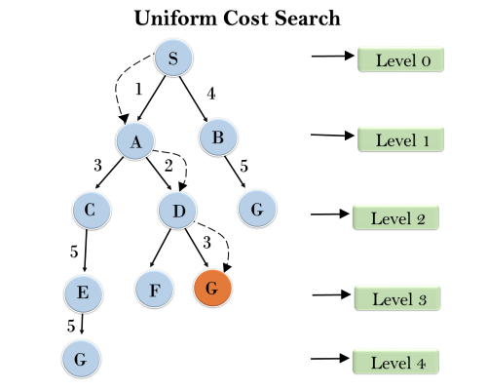
Continue…
Example:

Slide 35
Continue…
Completeness:
Uniform-cost search is complete, such as if there is a solution, UCS will find it.
Time Complexity:
Let C* is Cost of the optimal solution, and ε is each step to get closer to the goal node. Then the number of steps is = C*/ε+1. Here we have taken +1, as we start from state 0 and end to C*/ε.
Hence, the worst-case time complexity of Uniform-cost search is O(b^{1 + [C*/ε]}).

Slide 36
Continue…
Space Complexity:
The same logic is for space complexity so, the worst-case space complexity of Uniform-cost search is O(b^{1 + [C*/ε]}).
Optimal:
Uniform-cost search is always optimal as it only selects a path with the lowest path cost.

Slide 37
MCQ
Q1. In which of the following situations might a blind search be acceptable?
a) real-life situation
b) complex game
c) small search space
d) all of the mentioned

Slide 38
MCQ
Q2. Which search method takes less memory?
a) Depth-First Search
b) Breadth-First search
c) Optimal search
d) Linear Search

Slide 39
MCQ
Q3. Which search strategy is also called as blind search?
a) Uninformed search
b) Informed search
c) Simple reflex search
d) All of the mentioned

Slide 40
MCQ
Q4. Which search is implemented with an empty first-in-first-out queue?
a) Depth-first search
b) Breadth-first search
c) Bidirectional search
d) None of the mentioned

Slide 41
MCQ
Q5. When is breadth-first search is optimal?
a) When there is less number of nodes
b) When all step costs are equal
c) When all step costs are unequal
d) None of the mentioned

Slide 42
MCQ
Q 6. What is the space complexity of Depth-first search?
a) O(b)
b) O(bl)
c) O(m)
d) O(bm)

Slide 43
MCQ
Q7. Which search implements stack operation for searching the states?
a) Depth-limited search
b) Depth-first search
c) Breadth-first search
d) None of the mentioned

Slide 44
MCQ
Q8. Which data structure conveniently used to implement BFS?
a) Stacks
b) Queues
c) Priority Queues
d) All of the mentioned

Slide 45
MCQ
Q9. uniform-cost search expands the node n with the __________
a) Lowest path cost
b) Heuristic cost
c) Highest path cost
d) Average path cost

Slide 46
MCQ
Q10. Depth-first search always expands the ______ node in the current fringe of the search tree.
a) Shallowest
b) Child node
c) Deepest
d) Minimum cost

Slide 47
MCQ
Q11. Breadth-first search always expands the ______ node in the current fringe of the search tree.
a) Shallowest
b) Child node
c) Deepest
d) Minimum cost

Slide 48
MCQ
Q12. LIFO is ______ where as FIFO is ________
a) Stack, Queue
b) Queue, Stack
c) Priority Queue, Stack
d) Stack. Priority Queue

Slide 49
MCQ
Q13. DFS is ______ efficient and BFS is __________ efficient.
a) Space, Time
b) Time, Space
c) Time, Time
d) Space, Space

Slide 50
References
American Association for Artificial Intelligence (AAAI), Welcome to AI Topics, 2003, http://www.aaai.org/AITopics/ -- a Web-based library.
George Luger, Artificial Intelligence: Structures and Strategies for Complex Problem Solving, Fourth Edition Addison-Wesley, 2002 -- a well-respected introduction to artificial intelligence, as witnessed by its being in its fourth edition.
Peter Norvig, AI on the Web, http://aima.cs.berkeley.edu/ai.html -- a list of over 800 links on various aspects of artificial intelligence.

Slide 51


